Slide 1
The End of Binary Protocol Parser
Vulnerabilities
Tobias Reiher

Slide 2
A fairly simple protocol: UDP
0 7 8 15 16 23 24 31
+--------+--------+--------+--------+
| Source | Destination |
| Port | Port |
+--------+--------+--------+--------+
| | |
| Length | Checksum |
+--------+--------+--------+--------+
|
| data octets ...
+---------------- ...
User Datagram Header Format
“Length is the length in octets of this user datagram including this
header and the data.” RFC 768

Slide 3
Typical representation with a C struct
UDP
00
01
02
03
04
05
06
07
08
09
10
11
12
…
1023
source_port
unit16_t
dest_port
unit16_t
length
unit16_t
checksum
unit16_t
data[]
unit8_t

Slide 4
Typical representation with a C struct
UDP
00
01
02
03
04
05
06
07
08
09
10
11
12
…
1023
source_port
unit16_t
dest_port
unit16_t
length
unit16_t
checksum
unit16_t
data[]
unit8_t
00
0B
XX
XX
XX
Expected data length: 3 bytes (= 11 - 8) Actual data length: 3 bytes

Slide 5
What could go wrong?
UDP
00
01
02
03
04
05
06
07
08
09
10
11
12
…
1023
source_port
unit16_t
dest_port
unit16_t
length
unit16_t
checksum
unit16_t
data[]
unit8_t
08
00
XX
XX
XX
04
04
04
Expected data length: 2040 bytes (= 2048 - 8) Actual data length: 3 bytes
Buffer overflow!

Slide 6
What could go wrong?
UDP
00
01
02
03
04
05
06
07
08
09
10
11
12
…
1023
source_port
unit16_t
dest_port
unit16_t
length
unit16_t
checksum
unit16_t
data[]
unit8_t
00
00
XX
XX
XX
04
04
04
Expected data length: 65528 bytes (= 0 - 8) Actual data length: 3 bytes
Integer underflow!
Buffer overflow!

Slide 7
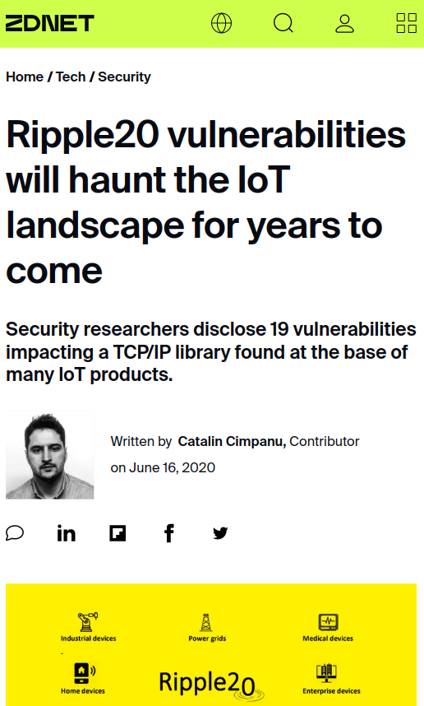
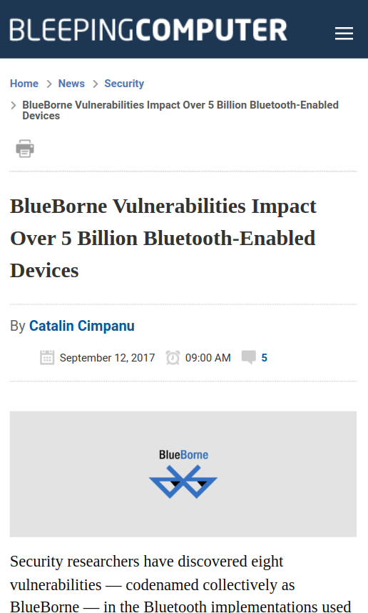
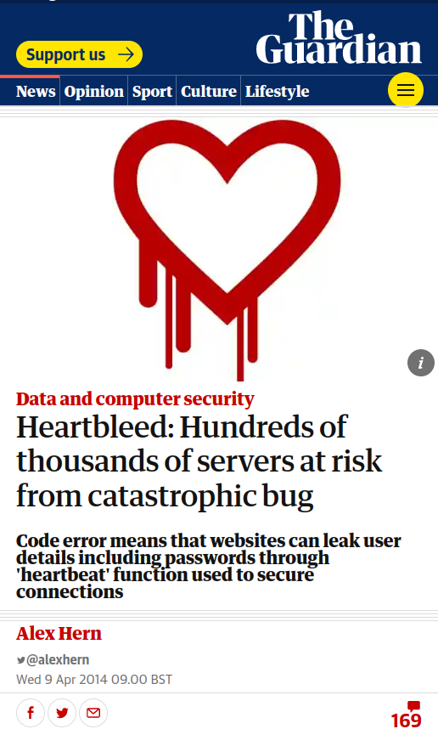
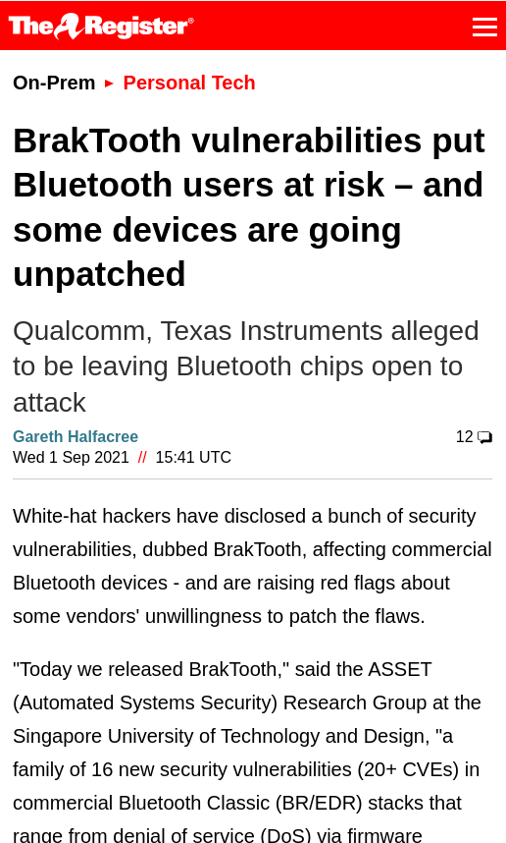
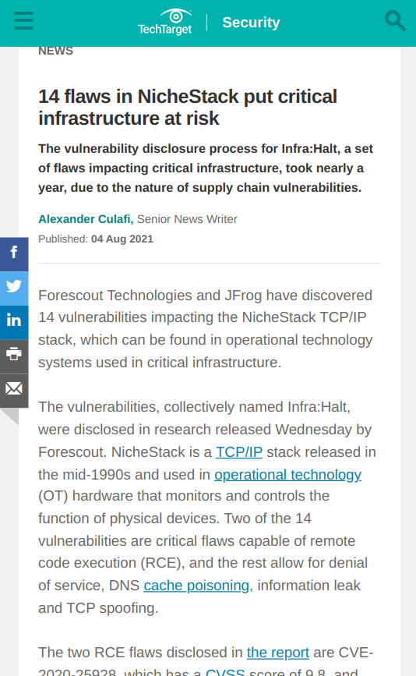
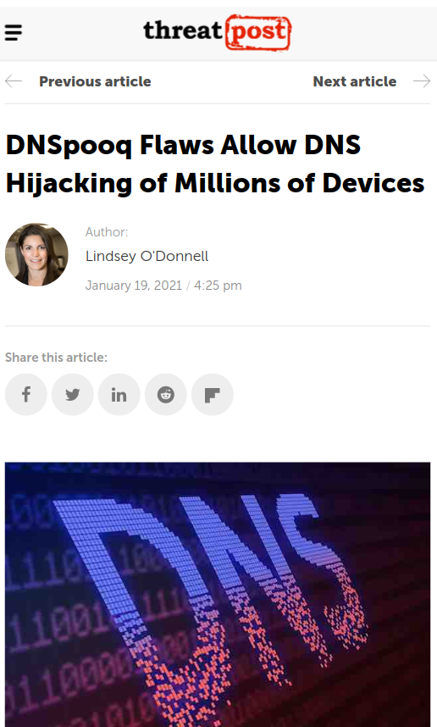
Real consequences and huge costs
What are we going to do about that?

Slide 9
Better representations
UDP
Src_Port
U16
Dest_Port
U16
Length
U16
Checksum
U16
Data
Opaque
Size => 8 * (Length - 8)
type U16 is range 0 .. 2 ** 16 - 1 with Size => 16

Slide 10
Proofs on the model level
UDP
Src_Port
U16
Dest_Port
U16
Length
U16
Checksum
U16
Data
Opaque
Size => 8 * (Length - 8)
type U16 is range 0 .. 2 ** 16 - 1 with Size => 16
model: error: negative size for field "Data" (Src_Port -> Dest_Port -> Length -> Checksum -> Data)

Slide 11
Option #1: Introduce explicit invariant
UDP
Src_Port
U16
Dest_Port
U16
Length
U16
Checksum
U16
Data
Opaque
if Length >= 8
Size => 8 * (Length - 8)
type U16 is range 0 .. 2 ** 16 - 1 with Size => 16

Slide 12
Option #2: Use constraint length type
UDP
Src_Port
U16
Dest_Port
U16
Length
Length_T
Checksum
U16
Data
Opaque
Size => 8 * (Length - 8)
type U16 is range 0 .. 2 ** 16 - 1 with Size => 16
type Length_T is range 8 .. 2 ** 16 - 1 with Size => 16

Slide 13
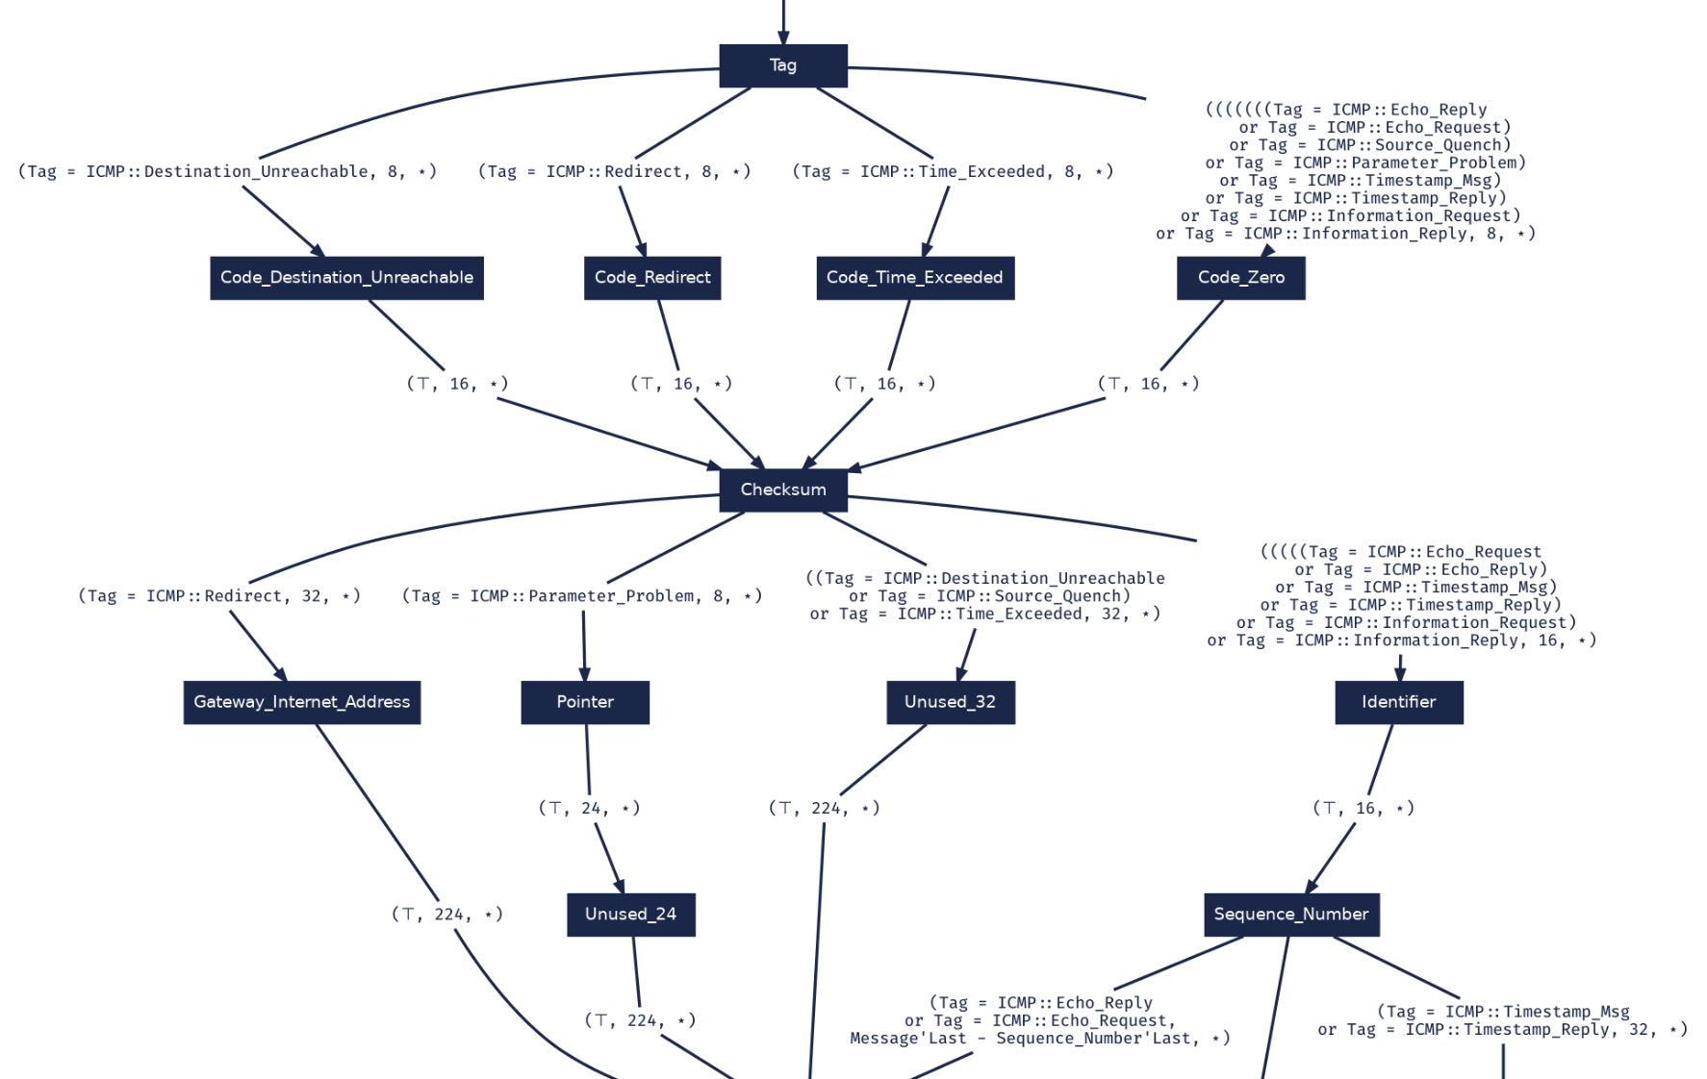
A fragment of an ICMP message model

Slide 14
Guarantees from message verification

Slide 15
How do we bridge the gap between specification and implementation?

Slide 16
SPARK as our target language
Common Core Language
Including executable functional contracts:
Preconditions
Postconditions
Ada
Features outside the SPARK subset
SPARK
Additional aspects to further aid static analysis
learn.adacore.com

Slide 17
Guarantees from program verification

Slide 18
Modelling dynamic protocol behavior

Slide 19
Interacting FSMs with context
Process
Plain := Decrypt (Message)
Receive
Message’Valid
Network’Read (Message)
not
Message’Valid
…
Error
Network’Write (Err_Msg)
Network

Slide 20
Guarantees from session verification

Slide 21
RecordFlux toolset
Validator
Formal Protocol Specification
(Legacy) Application
Formal
Message
Specification
Formal
Session
Specification
Domain
Expert
Simulator
Modeller
Informal
Specification
Generator
Verifier
Converter
Verified
SPARK
Source
Proof
Formal
Specification

Slide 22
RecordFlux workflow
Validation
Conversion
Specification
Model Verification
Code Generation
Program Verification
Simulation

Slide 23
RecordFlux
Industrial Application

Slide 24
NVIDIA adopts SPARK for critical firmware
adacore.com/nvidia

Slide 25
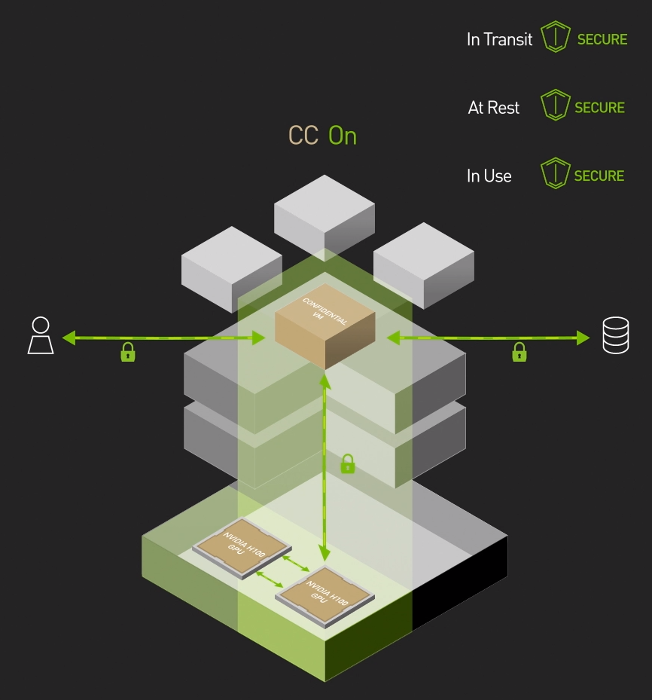
Security Protocol and Data Model (SPDM)
adacore.com/papers

Slide 26
SPDM formalization with RecordFlux
Message
specification
SPARK
code
1800 LOC
35 KiB
RISC-V code
1200
LOC
60
states
132 kLOC
3k
0
runtime
errors
Session specification
SPARK
contracts
RecordFlux/SPARK SPDM implementation:
github.com/AdaCore/spdm-recordflux

Slide 27
The Future

Slide 28
adacore.com/recordflux
Tobias Reiher
reiher@adacore.com

